Slide 1
Boozymeter
A Real-Time Mobile Survey of Alcohol Use and Sexual Consent in Social Research Participants
Samiksha Mailarpwar
Alex Lambrecht

Slide 2
AGENDA
Brief Overview
App Layout/Basic Features
Timeline
Challenges
Demo

Slide 3
Overview
School of Public Health and Social justice
Purpose: view data slices to perform analyses regarding both alcohol consumption and sexual consent
Create mobile app that tracks in real time alcohol consumption and sexual consent
provide a web facing dashboard for researcher to provide preliminary analyses
Participants answer questionnaires in the app that are logged into secure database
Mobile App Survey (Android) - Capstone I
Web-Facing Portal for Researcher - Capstone II

Slide 4
Timeline
Deliverable 2:
Functioning App
Login Credentials
Morning Questionnaire
Morning Report
August 9
Deliverable 4:
Working version of updated app and web-facing portal
end of Spring 2018
FALL 2017
Deliverable 1:
Location
Communication with cloud/server
Time Stamp
UI Sketches
June 30
Deliverable 3:
User-facing layout
web element
1/2 through Spring 2018

Slide 5
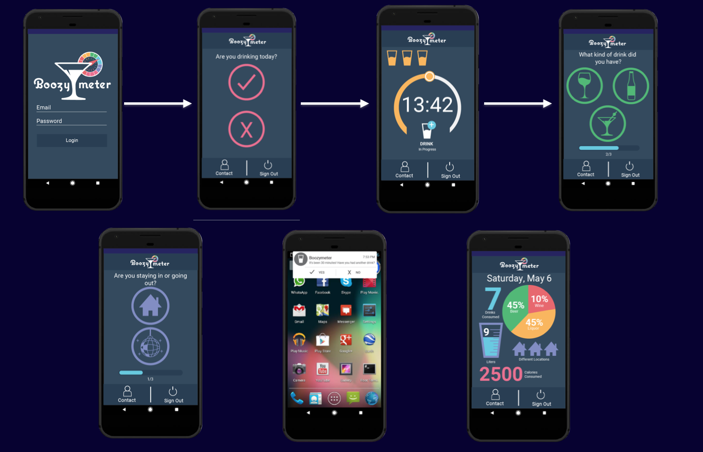
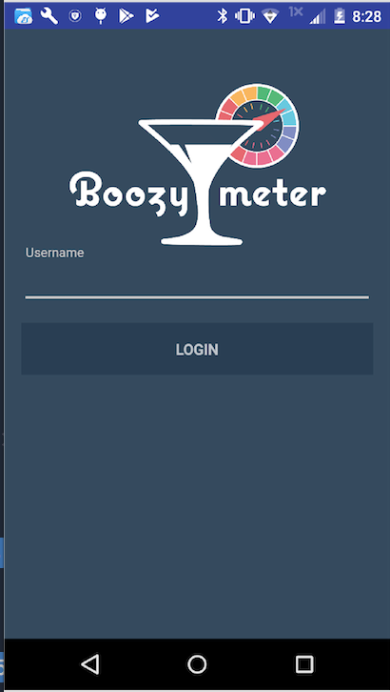
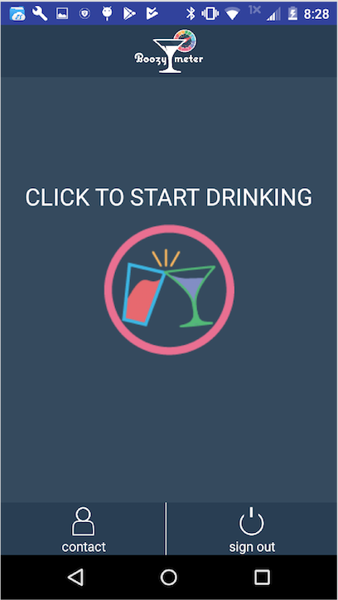
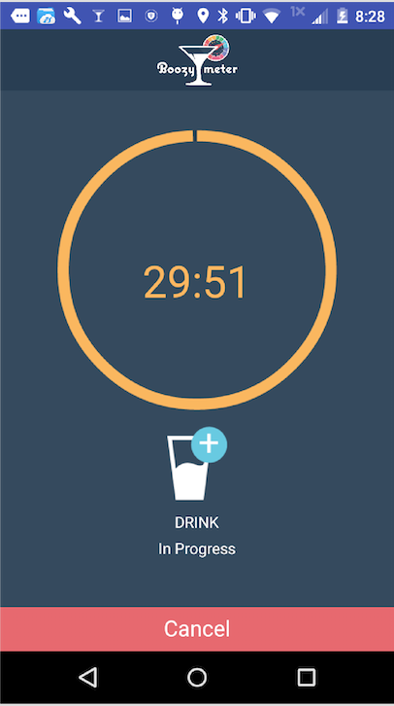
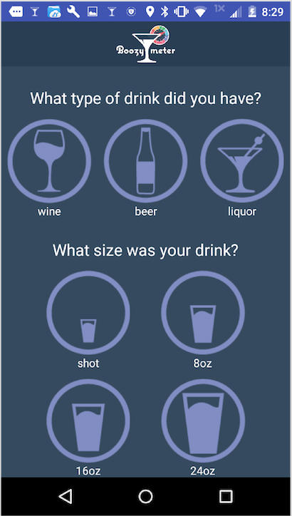
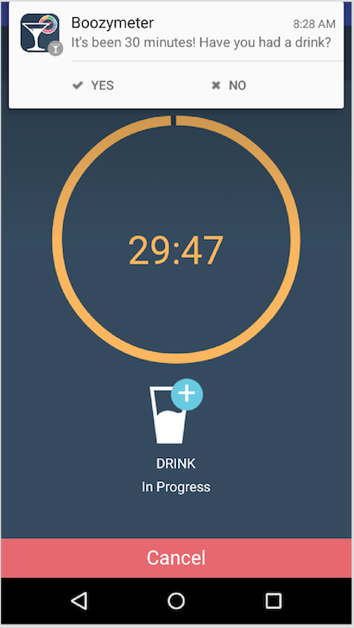
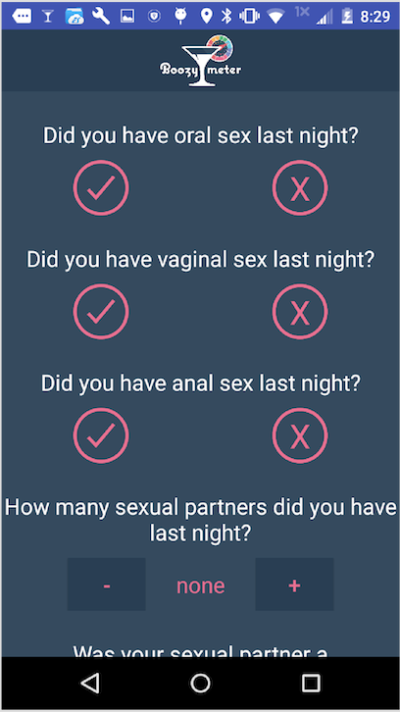

Slide 6
Basic Features of App
User can… (Active interactions)
report type of drink
number of drinks
size of drink
Other Questions proposed by Researcher
App… (Passive interactions)
Tracks location/time
Logs Answers to questions
Prompts morning questionnaire
Prompts morning report

Slide 7
Deliverable 1
June 30, 2017
List of Requirements
Communication with Server
Location
Login code and Firebase set up
Keeping track of specific tasks (Microsoft Visual Studio)
Setting up and committing to GitHub

Slide 8
Deliverable 2
August 9, 2017
Completed App:
Login, Timer, Location
During drinking questions
Morning questionnaire
Morning report (basic analyses conducted)
List of unique username strings (Excel)
Looking forward to Spring 2018 (Capstone II)
wireframe for the Web Portal
figure out way of exporting dummy data from Firebase to Excel

Slide 9
Next Steps: Capstone 2 (aka Pt. 2)
Figure out how to get app to participants (Fall 2017) - researcher’s decision
Manually download app on phones
Publish on App Store - relatively long process
Get data from Firebase JSON tree to Excel
Learn and research data tools in Excel to perform analysis on data (Power Query?)
Fix/Update App

Slide 10
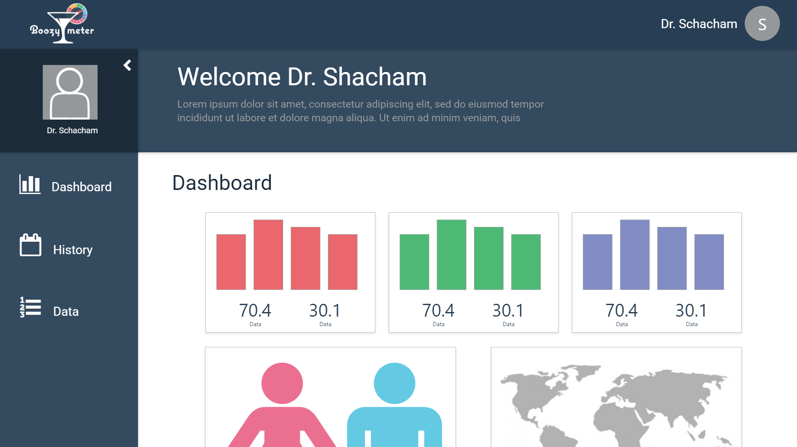

Slide 11
Hurdle 1: Steep Learning Curve, Time Crunch

Slide 12
Hurdle 2: Learning/Using Firebase

Slide 13

Firebase
Google’s mobile/web platform
assign each user a unique string of characters/numbers
Login Activity: user only has to input the unique participant “code”
app authenticates by connecting to Firebase
app remembers user on that specific phone
will not prompt re-login unless “Sign out” button hit by user

Slide 14
Hurdle 3: App Lifecycle (Activities, Services, Receivers)
i.e. Countdown Timer and Location Service

Slide 15
Activities
LoginActivity
StartActivity
MainActivity
Main2Activity
MorningQS
MorningReport
*OfflineActivity
Receivers
ButtonReceiver
TimerReceiver
Services
BroadcastService
LocationUpdates
NotificationService
BackgroundLocationService

Slide 16
DEMO

Slide 17
Android Developer Pages
basic skeleton code for:
alarm manager
notification builder
basic idea of services and receivers
basic login structure
Google API
Read/Write/Filter data from Firebase
Location Services
Other OpenSource Libraries
Pie Chart
Location Service
APIs Used

Slide 18
Deliverable 3
Mid-term Spring 2018
Preliminary Analyses determined through meetings with researcher
Tie to demographics
collected by Dr. Shacham
Averages
Display number of Users
Figure and lay out method to get from Firebase data to Web Portal
Adding additional features/fixing bugs found in pilot app

Slide 19
Deliverable 4
End of term Spring 2018
Completed Web Portal
Fixed and updated Mobile App

